Slide 1

Development Best Practices & Reusability
Ubaid Baig

Slide 2
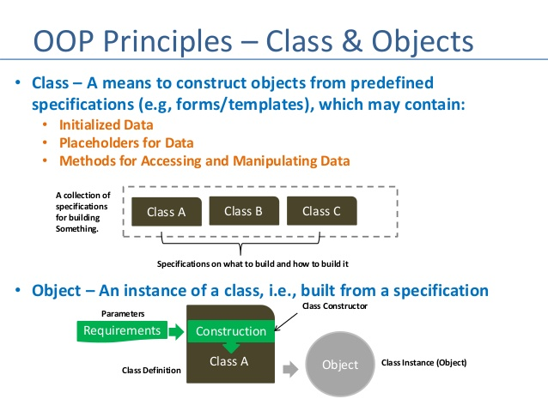
What we are NOT covering?

Slide 3
Agenda
Why Best Practices are being shared
Factors on which Developers’ work quality depends
What is required from each stakeholder so that developers can produce better quality
General / Software Development Best Practices
Our Focus on Reusability
Engineering Pulse

Slide 4





10Pearls Objective to achieve quality
Compliance and confirmation to a given set of functional requirements
Meeting the non-functional requirements
Does the software work when needed?
Notes:
subjective term
need to define it in qualitative terms
if it works then it is good

Slide 5
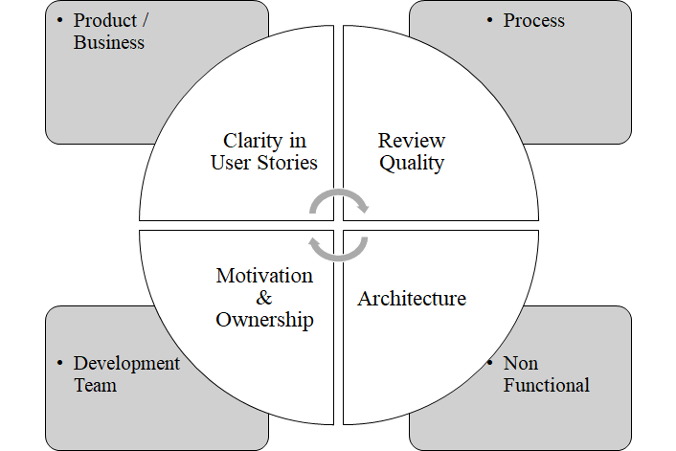
Developers Artifacts Dependencies
Notes:
Quality is a shared responsibility

Slide 6
Best Practices

Slide 7

General Do’s and Don’ts (Work Ethics)
Don’t jump straight into the code
Don’t leave dead / commented code
Don’t deploy on Fridays / public holidays *
Don’t deploy without Automation Testing
Don’t deploy manually
Don’t use too many gadgets
Keep your notifications off during work time / schedule them for breaks
Avoid reading news - unless you can manage distraction
Be always polite - when you don’t know what to say be silent
Read about negotiation
Keep a learning attitude
Notes:
time given in analysis / discussion / sharing ideas saves time later
gadgets tend to decrease productivity

Slide 8
Software Development - Dos and Don’ts
Use version control and follow simplest pipeline
use GitFlow if you don’t have any other strategy
Do peer reviews as well as PR reviews - Don’t merge without review
Don’t hard code, extract method or service or configuration
Use Static Code Analysis tools
Use S.O.L.I.D
Unit Testing (full stop)
Run static analyzer and Unit tests on Pull Requests
Notes:
Peer review - doesn’t matter senior v/s junior, it gives a second pair of eyes, different perspective
Penalize if someone merges without review
hard coding - makes your code single point of failure - cannot scale
Static code analysis checks your early, keeps it clean, manages dependencies for you, highlight potential vulnerabilities
Learn Unit Testing again and again, Write tests for legacy code. Unit Test is a litmus test for your code. If you cannot test your code don’t write please
Make existing code Unit Testable

Slide 9
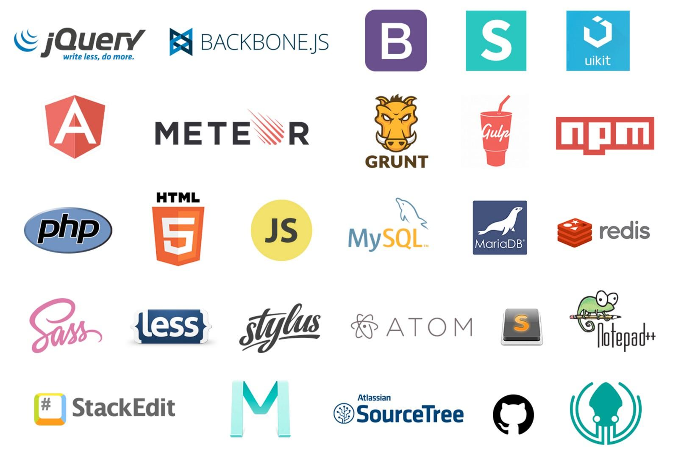
Web Development - Dos and Don’ts
Make REAL use of Angular/React Component
Don’t manipulate DOM in Controllers
Use CSS for styling instead of inline styling in html
Manage State / Behavior using Model Classes rather than in components
Unsubscribe to events that are not necessary to save memory
Use proper deep linking to pages
Divide your Views to take advantage of Lazy Loading
Notes:
Break functionality logical into Components
use OnDestroy lifecycle hook to unsubscribe
Or don’t manipulate DOM at all

Slide 10
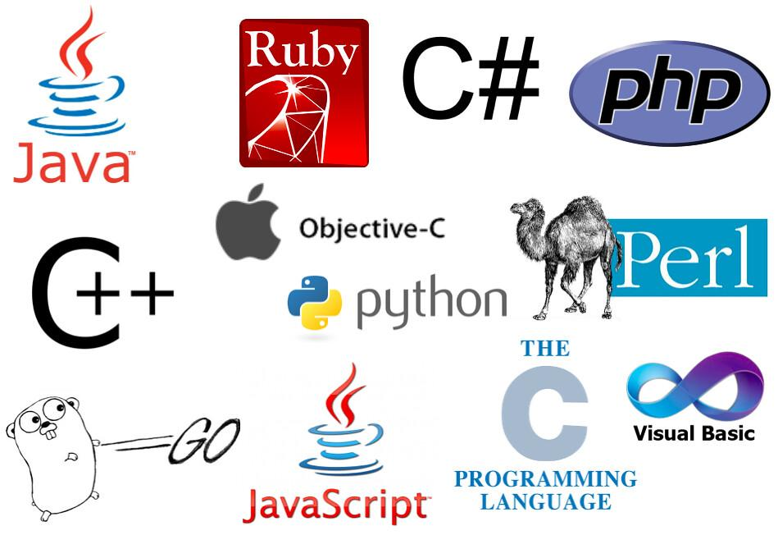
Backend Development - Dos and Don’ts
Don’t make database calls in a loop ever
Use Async pattern wherever possible
Save dependent entries in transaction to avoid partial / unlinked entities
Avoid large string concatenation, using StringBuilder / StringBuffer
Profile your code early and often
In Web Context - don’t create unhandled / uncontrolled threads
Run/deploy cron jobs in separate container / system
Validate all input at service level, and throw custom business exception
Design your database in iterations
Follow REST best practices
Use ORM the way it should be
Notes:
Input validation can be static / local or be done by validating input through database
Insert, Update, Delete => ORM, Reporting, Complex Queries => SQL, Searching => Views /Full Text , Extensive Search => ETL , Document Search => Elastic Search
use CORs wisely and set your headers correctly

Slide 11

iOS Development - Dos and Don’ts
Follow MVVM-C Architecture
Follow repository pattern for local database
Use Keychain for sensitive data
Debugging Logs should be done using DEBUG and not in RELEASE mode
Use Abstraction Layer for Network Calls
Use Protocol Oriented Programming / Delegate Drive Development
Use CocoaPods for dependency management
Keep your constant scope as small as possible (instead of having one large file)
Further iOS Best Practices
Notes:
Program to Interfaces rather than classes

Slide 12

Android Development - Dos and Don’ts
Follow MVP Architecture
Use Abstraction Layer for Network Calls
Distribute packaging with respect to functionalities
Keep dependencies in separate file, and maintain each by version
Change target API version to >= 26 for Android Pie Support
Further Android Best Practices
Notes:
Program to Interfaces rather than classes

Slide 13

Our Focus on Reusability
Code Reusability is the use of existing code, or software knowledge, to build new software. It is an effective and efficient way to code, provided all reusability principles are followed through.
Use of design patterns
Component based development
Service oriented approach
Benefits
Accelerates development
Increases effectiveness
Positive impact on quality
Increases reliability
Notes:
Its NOT copy paste
Program to Interfaces rather than classes
Levels of reusability -> code , design , service/application, specifications

Slide 14

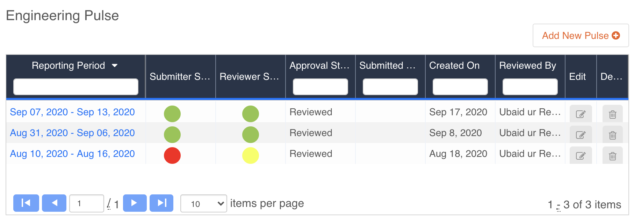
Engineering Pulse
Available on cogs https://cogs.10pearls.com/#/home
Keep Engineering Management informed about project’s health
Share success / Raise Flags
Take Proactive measures for making project a success!
Notes:
first try to resolve problems internally
Raise the flags with PM and Architects , not Engineering Problems
3 ways of raising a concern

Slide 15
Thank You

